Slide 1
RC6
VC 210 Recitation Class
Linda Wei
SJTU

Slide 2
Equilliburim

Slide 3
Physical Equilliburim
Vapor pressure
Phase Diagram
Solution

Slide 4
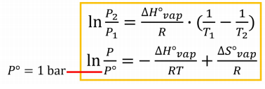
Vapor pressure
Comparision: Temperature higher vapor pressure higher, Intermolecule force greater, vapor pressure lower.
Clapeyron-Clausius Equation:

Slide 5
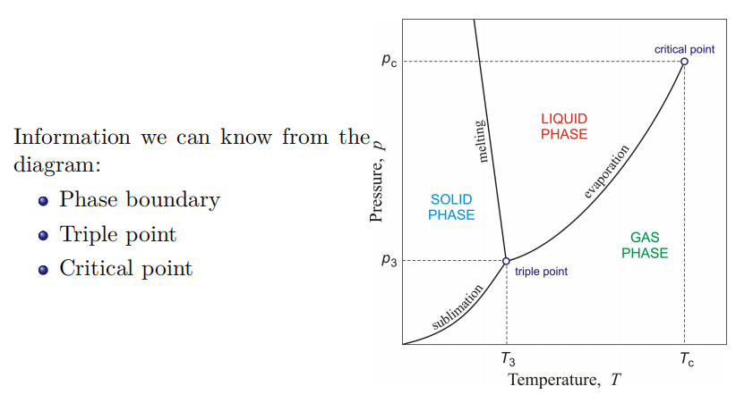
Phase Diagram

Slide 6
Solution
Solubility
General properties of non electrolyte solutions
1、Vapor pressure depression
2、Freezing point depression
3、Boiling point elevation
4、Osmosis

Slide 7
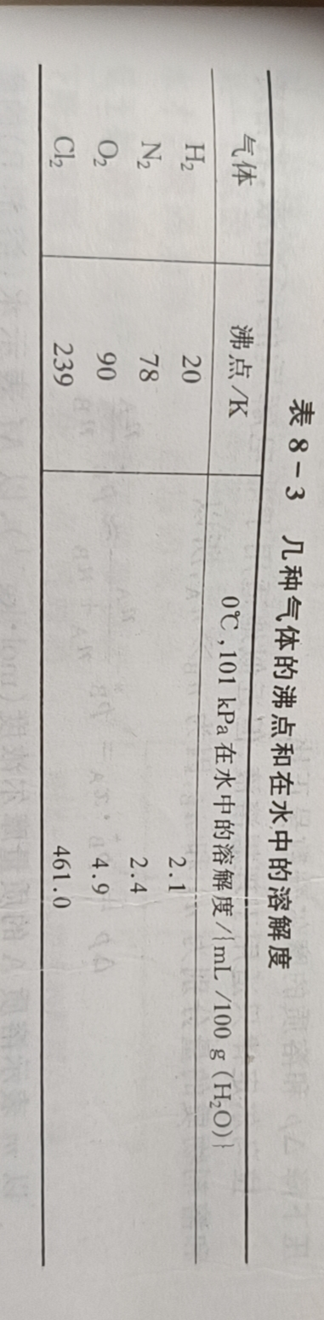

Solubility
1、principle of "like dissolves like"：
The more similar the intermolecular force between solute molecules and solvent molecules, the easier it is to dissolve each other.

Slide 8
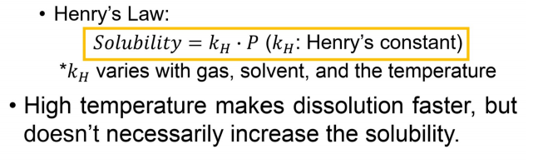
Henry’s Law
It is only valid for ideal gas and solution, some gases like HCL, NO2,don’t obey the rule

Slide 9
Vapor pressure depression

Slide 10
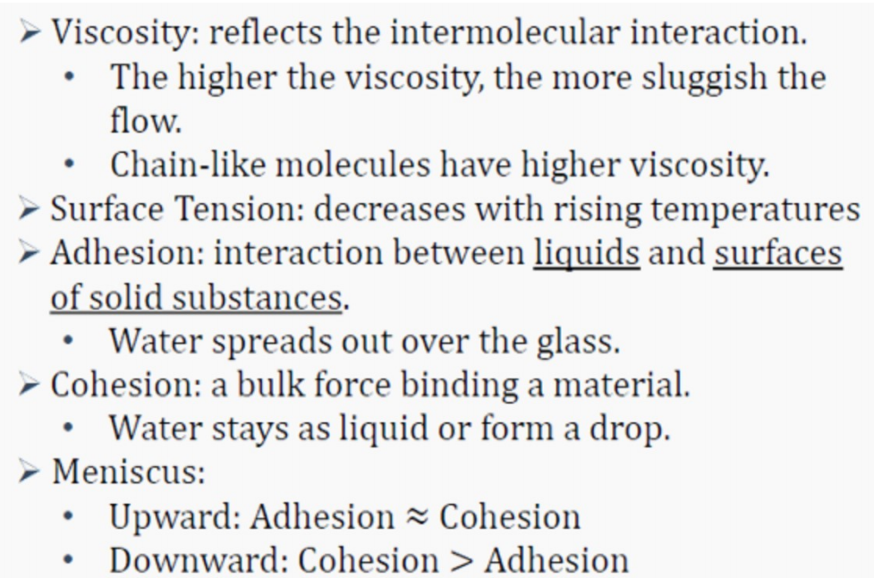
Liquid

Slide 11
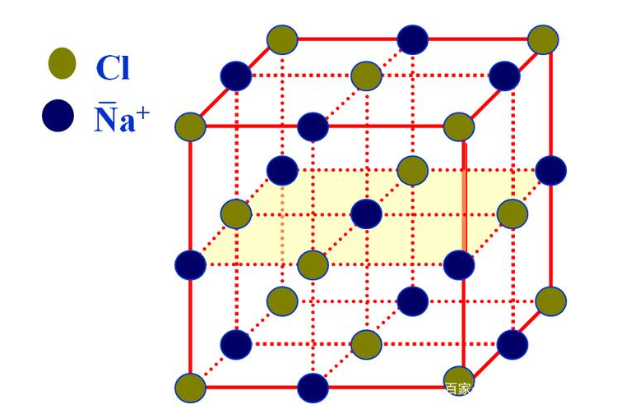
Solid--Crystal
Unit cell: the smallest region the crystal lattice
center:1
corner:1/8
face:1/2
edge:1/4
NaCl:
4 Na⁺,4Cl⁻

Slide 12
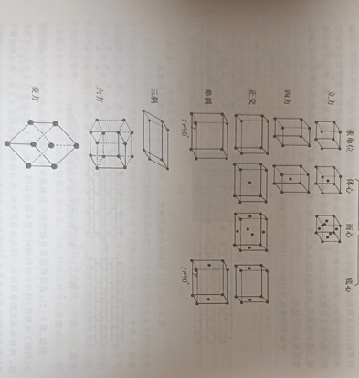
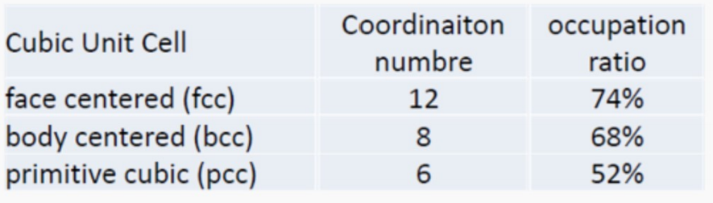
Bravais lattice
There are 14 forms of Bravais lattice in the three dimension lattice
In the general chemistry in JI, we only need to know about the cubic lattice.

Slide 13
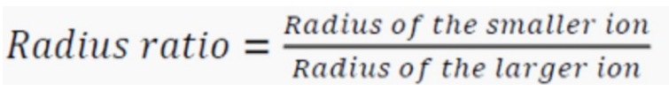
Radius Ratio
radius ratio < 0.414(sqrt2-1): fcc
0.414 (sqrt2-1)< raius ratio < 0.732(sqrt3-1): bcc
radius ratio > 0.732(sqrt3-1): pcc

Slide 14
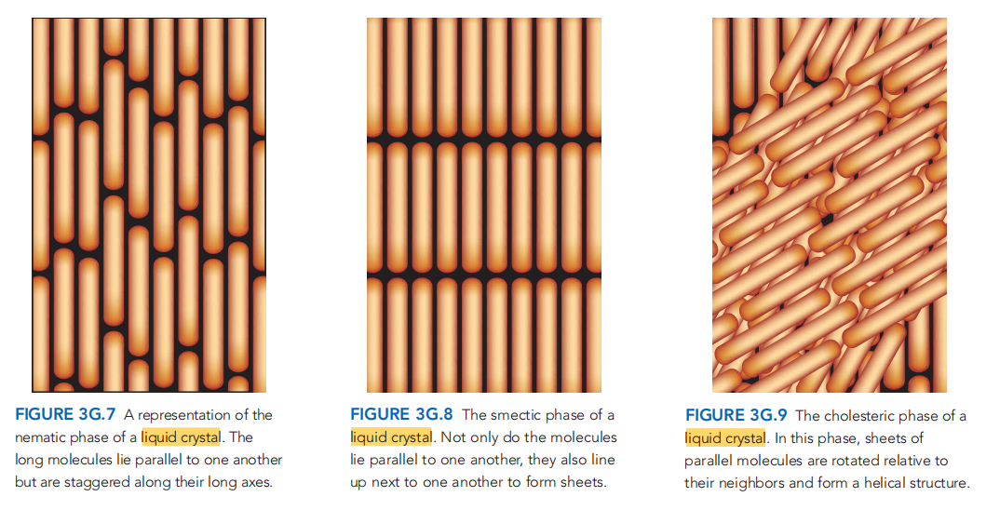
Liquid Crystal
From chemical principle,Knowing about their name and look is enough,copy a draft on your cheating paper.

Slide 15
Thank you

Slide 16
Reference
[1] CHEMICAL PRINCIPLES-THE QUEST FOR INSIGHT
(Seventh Edition)
[2] Wei Xiwen, RC2, VC210 FA2020
[3] Zhou Gongdu, structural chemistry

